Slide 1
Session 5
New Roles for Libraries
Jeff Trzeciak

Slide 2
New Roles for Libraries Stewardship, Discovery and Preservation of Born-digital Resources
Jeffrey Trzeciak
HKUL Leadership Institute 2018
Hong Kong

Slide 3
Outline
Building on our strengths
Changing faculty views of the role of the library
Impact of trends and embracing opportunity
Case study: Documenting Ferguson
Exercise

Slide 4
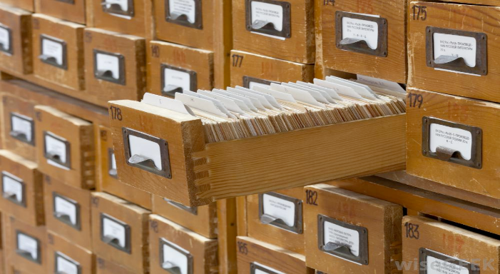
Building on our strengths: Our traditional core
Stewardship
Discovery
Preservation

Slide 5
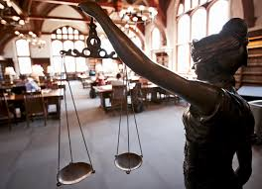
Ithaka S+R US Faculty Survey 2015
Track the changing research, teaching, and information usage practices of faculty members
Sixth triennial cycle, surveying a random sample of US higher education faculty members
Key findings include:
Discovery starting points remain in flux
Traditional roles still very much valued
http://www.sr.ithaka.org/wp-content/uploads/2016/03/SR_Report_US_Faculty_Survey_2015040416.pdf
Notes:
The Ithaka S+R Faculty Survey has examined the attitudes and behaviors of scholars at four year colleges and universities across the United States on a triennial basis since 2000.
tool for tracking attitudes and self reported practices of scholars on a variety of issues over time.
help the higher education community understand the changing needs of faculty members as they relate to key issues such as the discovery process, collecting and col
lections, the value of the library, and publishing.
libraries have more recently supported discovery througha variety of digital tools including the library website, catalog, and discovery services. starting in 2012, we have seen a reversal of the trends for beginning with an online library website or catalog, which had been declining prior to 2012, and for a specific electronic research resource / computer database, which had previously been on the rise.

Slide 6
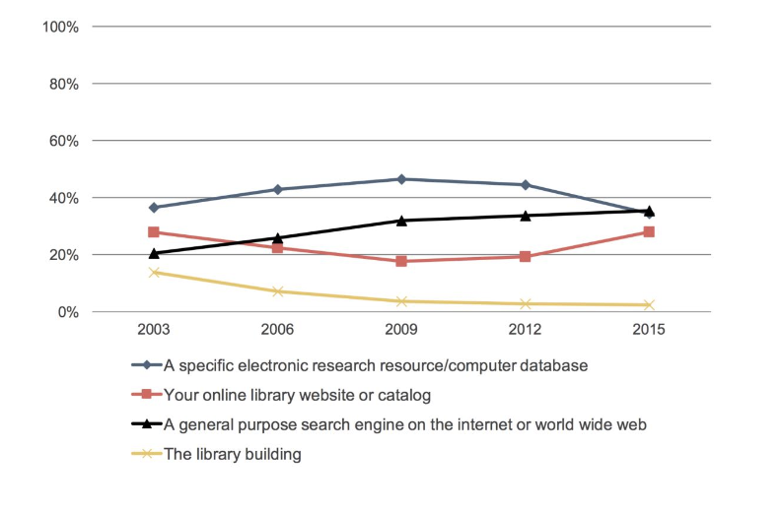
Ithaka S+R US Faculty Survey 2015:
Discovery remains in flux
http://www.sr.ithaka.org/wp-content/uploads/2016/03/SR_Report_US_Faculty_Survey_2015040416.pdf
Notes:
The Ithaka S+R Faculty Survey has examined the attitudes and behaviors of scholars at four year colleges and universities across the United States on a triennial basis since 2000.
tool for tracking attitudes and self reported practices of scholars on a variety of issues over time.
help the higher education community understand the changing needs of faculty members as they relate to key issues such as the discovery process, collecting and col
lections, the value of the library, and publishing.
libraries have more recently supported discovery througha variety of digital tools including the library website, catalog, and discovery services. starting in 2012, we have seen a reversal of the trends for beginning with an online library website or catalog, which had been declining prior to 2012, and for a specific electronic research resource / computer database, which had previously been on the rise.

Slide 7
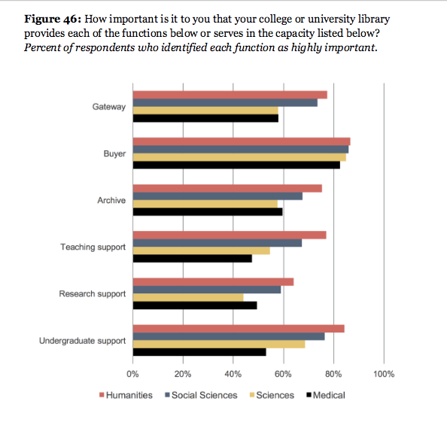
Traditional roles including archiving still valued

Slide 8
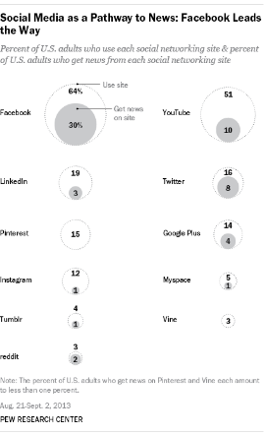
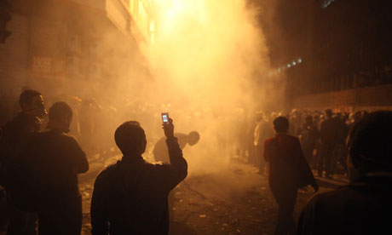
Major trends The Problem Statement
What happens when stewardship, discovery and preservation involve social media?
http://www.theguardian.com/world/2011/dec/29/arab-spring-captured-on-cameraphones
http://www.pewresearch.org/fact-tank/2014/09/24/how-social-media-is-reshaping-news/

Slide 9
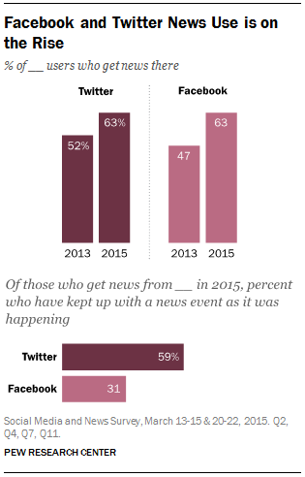
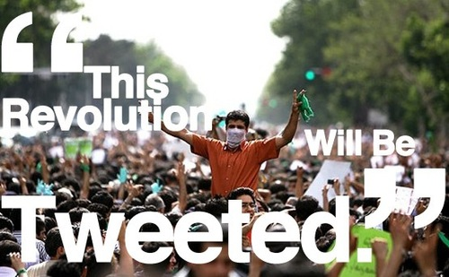
Major Trends The Problem Statement
…particularly when use of social media is growing exponentially?
http://www.journalism.org/2015/07/14/the-evolving-role-of-news-on-twitter-and-facebook/
http://blogs.lynn.edu/knightwriter/tag/social-movements/

Slide 10
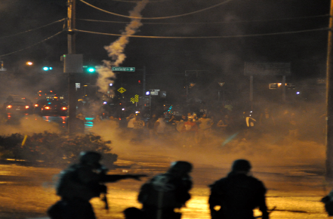
Case Study:
Stewardship, discovery and preservation of social media related to the ferguson riots

Slide 11
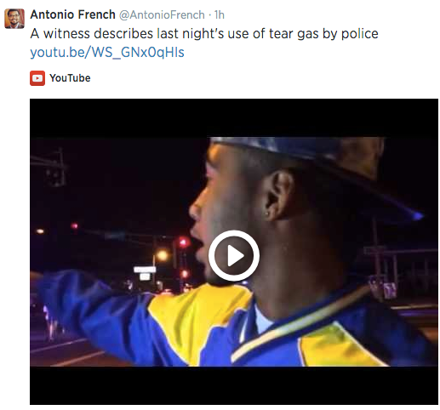
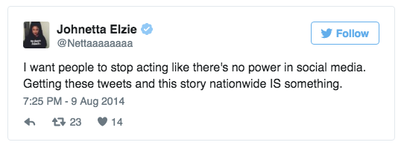
Problem Statement
Twitter was a primary source of information about the protests in and in the name of Ferguson.
How can organizations archive Twitter data and make that data set available to researchers in ways that are in compliance with the Twitter Terms of Service & ethically sound?

Slide 12
Project Team: Building on traditional expertise
Assembled August 21, 2014
Rudolph Clay, Head of Library Diversity Initiatives and Outreach Services, African & African-American Studies Librarian, and Urban Studies Librarian
Shannon Davis, Digital Library Services Manager
Meredith Evans, Associate University Librarian
Makiba Foster, American History, American Culture Studies, and Women, Gender, and Sexuality Studies Librarian
Chris Freeland, Associate University Librarian
Nadia Ghasedi, Film and Media Archivist
Jennifer Kirmer, Digital Archivist
Sonya Rooney, University Archivist
Micah Zeller, Copyright & Digital Access Librarian

Slide 13
Purpose
Preserve and make accessible community and media-generated, original content that was captured and created following the killing of 18-year-old Michael Brown
Create a freely available resource for students, scholars teachers, and the greater community
Provide diverse perspectives, especially those of the local community, of the events surrounding conflicts in Ferguson, MO

Slide 14
The collection
Community contributed content

Slide 15
Woman with Obama sign Greater Grace Church
Creator: Mark Regester
Date: August 17, 2014
Mark Regester, “Woman with Obama sign Greater Grace Church,” WUSTL Digital Gateway Image Collections & Exhibitions, accessed August 12, 2015, http://omeka.wustl.edu/omeka/items/show/8280.

Slide 16
Protesters holding signs in the street. W. Florissant
Creator: Mark Regester
Date: August 17, 2014
Mark Regester, “Protesters holding signs in the street. W. Florissant,” WUSTL Digital Gateway Image Collections & Exhibitions, accessed August 12, 2015, http://omeka.wustl.edu/omeka/items/show/8286.

Slide 17
Ferguson, Night 3, photo 4
Creator: Joel Levy
Date: August 11, 2014
Joel Levy, “Ferguson, Night 3, photo 4,” WUSTL Digital Gateway Image Collections & Exhibitions, accessed August 12, 2015, http://omeka.wustl.edu/omeka/items/show/8669.

Slide 18
Ferguson, Day 6, photo 45
Creator: Joel Levy
Date: August 14, 2014
Joel Levy, “Ferguson, Day 6, photo 45,” WUSTL Digital Gateway Image Collections & Exhibitions, accessed August 12, 2015, http://omeka.wustl.edu/omeka/items/show/8945.

Slide 19
Shaw neighborhood protests October 10, 2014
Creator: Adam Ehlen
Date: October 10, 2014
Adam Ehlen, “Shaw neighborhood protests October 10, 2014,” WUSTL Digital Gateway Image Collections & Exhibitions, accessed August 12, 2015, http://omeka.wustl.edu/omeka/items/show/10030.

Slide 20
Shaw Conversations (emails, agenda, and outcomes)
Creator: Anonymous
Date: October - November 2014
“Shaw Conversations (emails, agendas, outcomes),” WUSTL Digital Gateway Image Collections & Exhibits, accessed August 12, 2015, http://omeka.wustl.edu/omeka/items/show/10021.

Slide 21
Darren Wilson’s uniform and weapon
Source: The New York Times
Date: August 2014
Gore Perry Reporting & Video Company, “Case: State of Missouri v Darren Wilson. Photos: Photos of Darren Wilson’s uniform and weapon,” WUSTL Digital Gateway Image Collections & Exhibitions, accessed August 12, 2015, http://omeka.wustl.edu/omeka/items/show/10999.

Slide 22
News coverage from Ferguson, MO November 16, 2014
Creator: Argus Streaming News
Date: November 16, 2014 12:06 pm CST
Argus Streaming News, “News coverage from Ferguson, MO November 16, 2014,” WUSTL Digital Gateway Image Collections & Exhibitions, accessed August 12, 2015, http://omeka.wustl.edu/omeka/items/show/11429.

Slide 23
Other media
Oral histories
Audio
Video
Creative works

Slide 24
Contribution process
Enter basic information about your submission
OMIT creator name and email to remain anonymous to the public
Attach a file
Enter your name and email (required, but only visible to website administrator)
Agree to the Terms & Conditions
http://omeka.wustl.edu/omeka/contribution

Slide 25
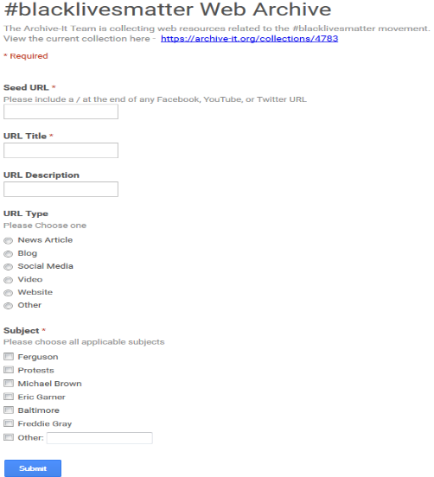
How do we build on existing resources: Archive-It

Slide 26
COLLECTING HISTORY AS IT HAPPENS
Traditional archive collections vs. Documenting Ferguson

Slide 27
Traditional Appraisal
includes research and input from different individuals
an evaluation of the collection content within the framework of a collection development policy
an assessment of the content for research use
an assessment of originality and authenticity
ownership transfers to archive

Slide 28
Documenting Ferguson collecting
no selection
no assessment of content
no quality control
copy of image/ document (the original remains on the creator’s device)
contributor retains rights

Slide 29
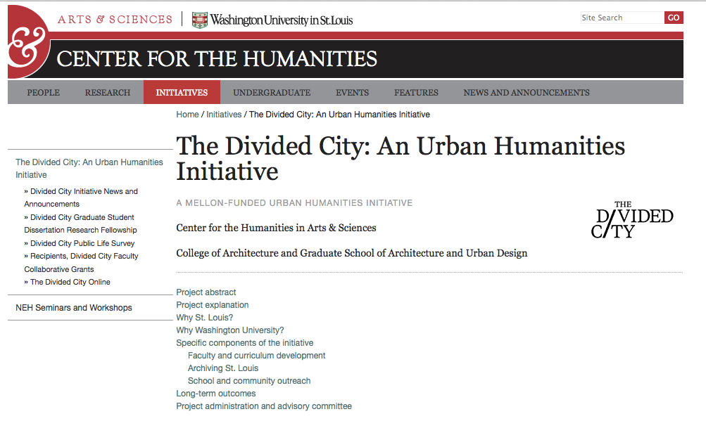
Mapping to local priorities

Slide 30
Exercise
What events are occurring right now that may be of interest to your research community today and beyond?
Where might your users find information about these events as they occur?
How can you help to steward, provide access to and preserve materials related to these events?
What challenges exist and how might you work together to overcome them?

